Slide 1
scribble
Developers :
Nicole Iwuala , Harini Arunprakash , Zaaim Rahman , Nicholas Donovan, Muhammad Ali , Amir Akilimali , Aditya Sinha , Pranav Balu

Slide 2
objective
Our goal is to build an instant messenger with a focus on accessibility, intuitive design, and simplicity. Scribble combines drawing tools and messaging features to allow users to communicate with other users through words and visuals easily.

Slide 3
project scheduling

Slide 4
Project Start Date: April 29, 2024 (Monday)
Project End Date: October 4, 2024 (Friday)
Work Schedule:
Weekly Hours: 40-hour work weeks
Daily Hours: 8 hours per day
Weekends: Excluded
Effort Calculation:
Estimated Effort: 45 person-months
Hours per Person / Month: 160 hours(Standard 4-week month)
Total Working Hours: 45 person-months × 160 hours/person-month=7200 hours
Hours per Team Member: 7200 hours÷ 8 members= 900 hours/member
Project Duration:
Calculation: 7200 hours÷(8 members×40 hrs/week)=22.5 weeks
Duration: 23 weeks

Slide 5
functional &
non-functional requirements

Slide 6
functional requirements
01.
02.
User Functionalities
System Functionalities

Slide 7
User Functionalities
The user shall be able to:
Dynamic Communications
Session Management
DCUF.1.
Draw, edit, delete SVG-Graphics
Upload Documents
Generate Canvas
SMUF.1.
Label and Group
Search and Delete Previous Sessions
SMUF.2.
Pin/Favorite Certain Sessions.
Messaging
MUF.1.
Send, View, Reply, and Delete Message Components
MUF.2.
Generate Sessions with Multiple Users.

Slide 8
System Functionalities
The system shall be able to:
Gestures
Notifications
GSF.1.
Scrolling to View Previous Messages
Tapping to Zoom In/Out Certian Components
NSF.1.
Notifications Sent to User Upon Message Receival

Slide 9
Non-Functional Requirements
Dependability
Space
Operational
efficient, scalable
99.5% uptime
Short maintenance periods
100 MB attachment limit
918 character limit
message compression and encryption
routine maintenance
monitoring and logging
software updates
Performance
Environmental
Security
real-time message delivery
100K messages per second
common, modern operating systems (Windows, macOS, etc.)
Internet connectivity
User authentication
Protections against common security threats

Slide 10
use case diagrams

Slide 11
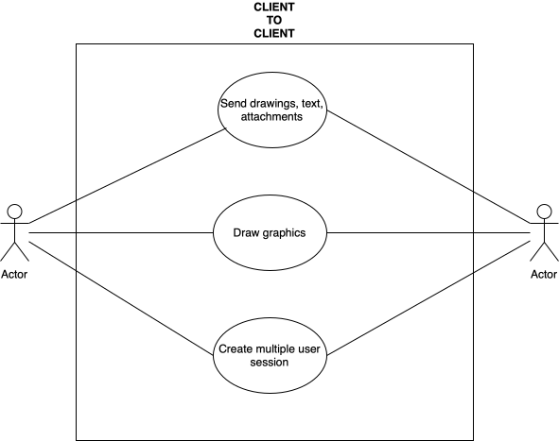
Client to Client

Slide 12
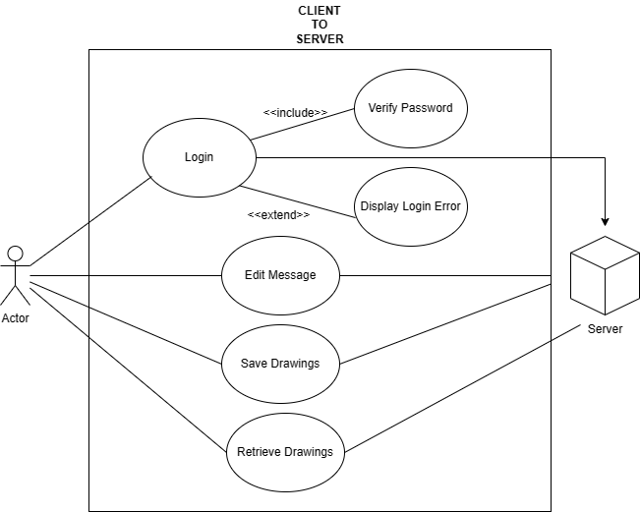
Client to Server

Slide 13
sequence diagrams

Slide 14
LOGIN

Slide 15
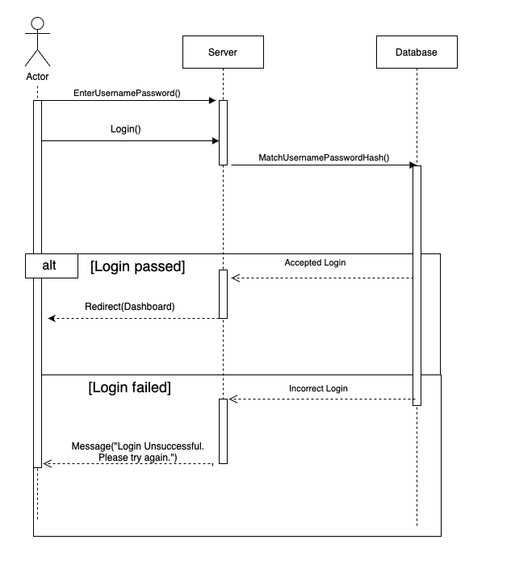

Slide 16
CREATE GROUP SESSION

Slide 17
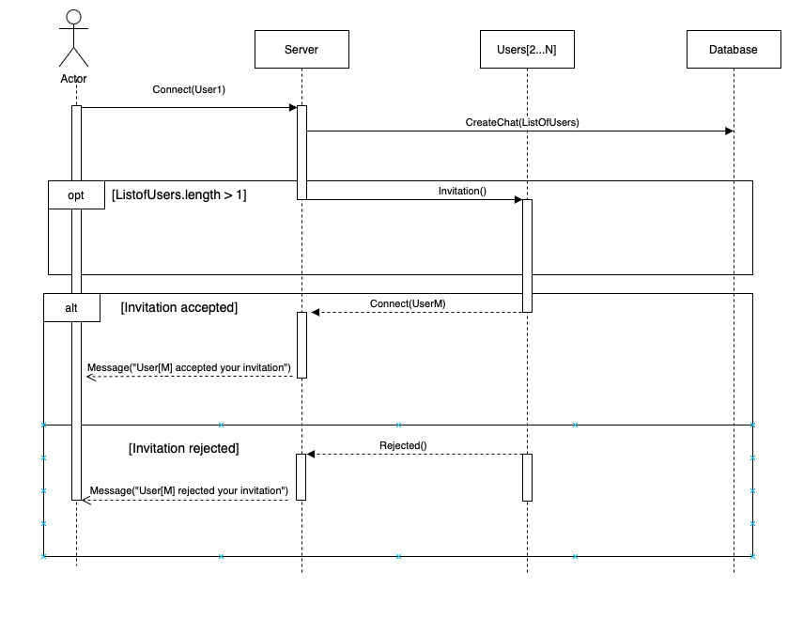

Slide 18
SEND MESSAGE

Slide 19
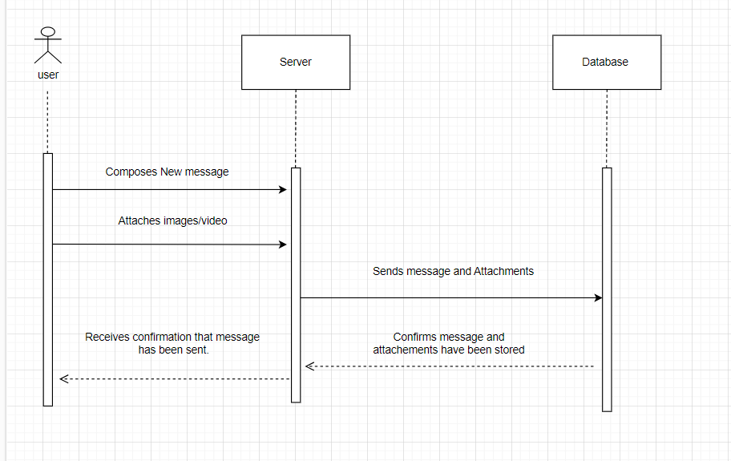

Slide 20
EDIT MESSAGE

Slide 21
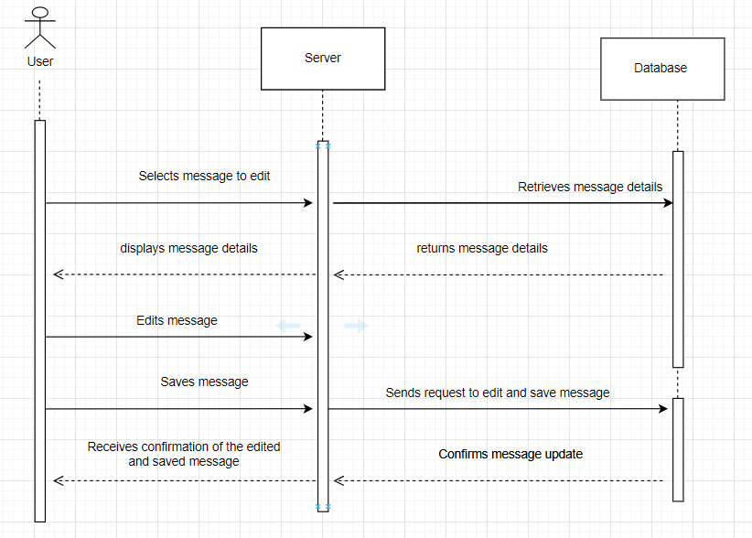

Slide 22
Save drawings

Slide 23
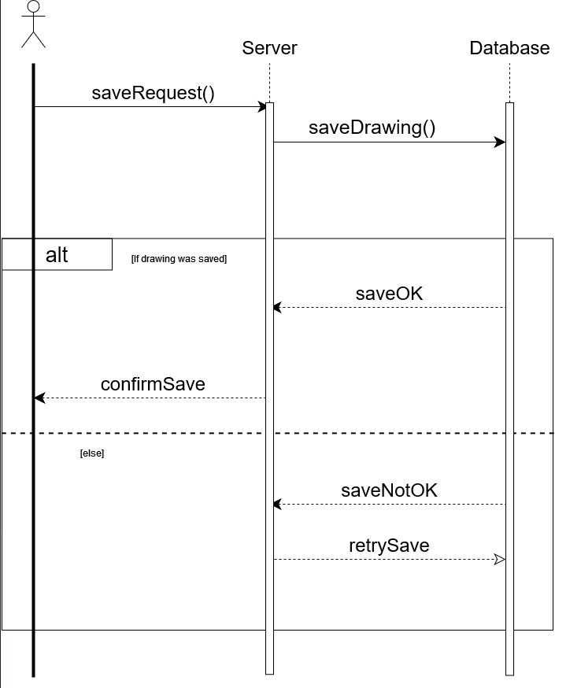

Slide 24
Retrieve drawings

Slide 25
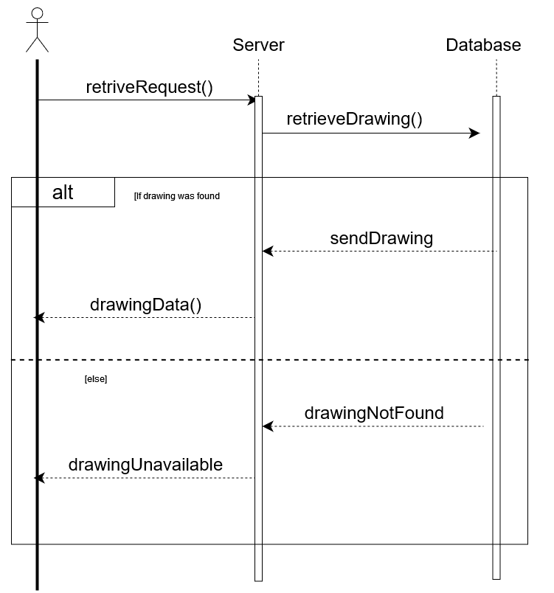

Slide 26
Draw Graphics

Slide 27
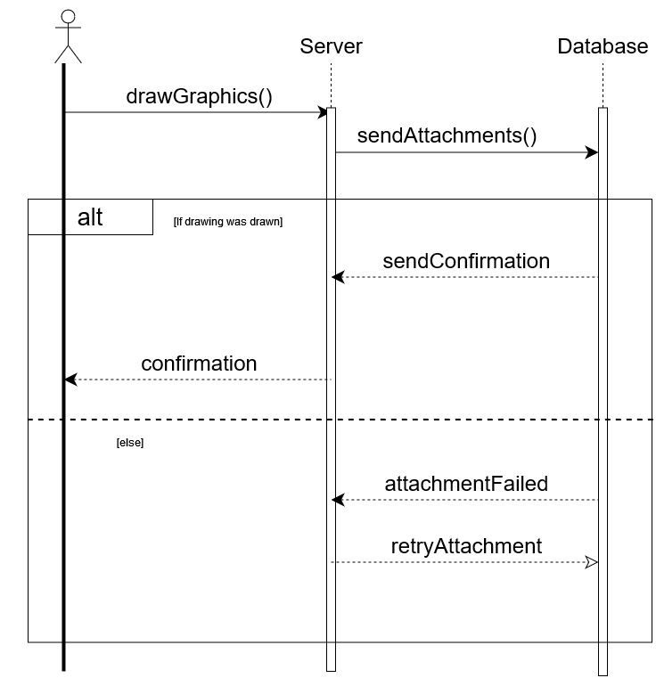

Slide 28
class diagram

Slide 29
Class Diagram

Slide 30
architectural design

Slide 31
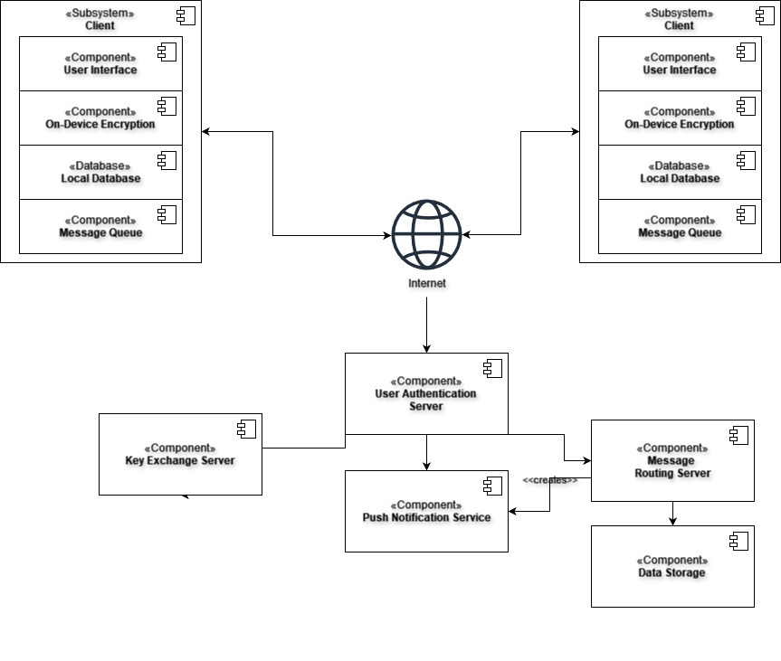

Slide 32
cost estimation

Slide 33
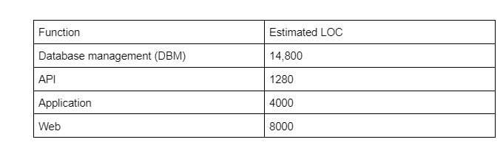
Cost Estimation (Lines of Code)
Database management - 14,800 LOC
Media - 2400 LOC
Message - 2800 LOC
Contacts - 1600 LOC
Groups - 1600 LOC
Profiles - 2400 LOC
Payment - 1600 LOC
Chats - 1600 LOC
Login - 800 LOC

Slide 34
Cost Estimation (cont’d)
Total LOC = 28,080
Average productivity for systems of this type = 620 LOC/person-month (Given)
Labor rate = $8000 per month
Based on the LOC estimate and the historical productivity data:
Cost per line of code = Labor rate / average productivity = $8000 / 620 = $13
Total estimated project cost = Cost per line of code × estimated LOC = $13 × 28,080 = $365,040
Estimated effort = estimated LOC / average productivity = 28,080 / 620 ≈ 45 person-months

Slide 35
Personnel Cost
There are 8 team members.
According to Payscale, the average annual salary for software developers is around $78,202 for people working for 0-5 years.
Salary per Developer: $78,202
Benefits and Taxes (assuming 30%): $23,460.60 (0.30 × $78,202)
Total Cost per Developer (Annual) = $78,202 + $23,460.60 = $101,662.60
For a team of 8 software developers, the total personnel cost would be:
Total Personnel Cost (Annual) = Number of Developers × Total Cost per Developer
Total Cost = 8 × $101,662.60
Total Cost = $813,300.80

Slide 36
Personnel Cost (cont’d)
AWS Software is being used for this project, so AWS Skill Builder will be used for training the developers during and before the project's timeline.
AWS Skill Builder Team subscription: $449 per seat/year (minimum 5 users per company)
Training for 8 people = $449 × 8 = $3,592
Total Cost for Developers and Training = Salary + Training
= $813,300 + $3,592 = $816,892 per year

Slide 37

Infrastructure as a Service (IaaS) & Platform as a Service (PaaS) | Cost per Month
AWS Elastic Compute Cloud (EC2) Amazon Linux OS Storage-optimized 10 instances per month X2gd.2xl 8vCPU 128 GiB memory 8,640,000,000 messages per day | $1,765.86
AWS Simple Storage Service (S3) | $993.60
AWS DynamoDB | $1768.33
Total | $4527.79

Slide 38
Software as a Service (SaaS) | Costs per Month
AWS Identity and Access Management (IAM) workload and workforce least privilege | $0.00
AWS Pinpoint | $100.00
AWS CloudWatch App performance Root cause analysis Monitoring and logging | $482.50
AWS Management Console | $0.00
Third-party Libraries | $500.00
GitHub Enterprise | $21.00
Total: | $1103.50
Estimated Total:
$5,631.29 per month
$67,575.48 per year

Slide 39
comparisons with competitors

Slide 40



Snapchat
Notelt
Pictoswap
Key Features: Self-destructing messages, stories, filters, and lenses
User Base: Popular among younger demographics for instant, visual, and spontaneous interactions
Key Features: Intimate social networking, widget-centric, shares thoughts directly on the home screen
User Base: Targets users seeking meaningful, persistent engagements and a quieter experience
Key Features: Artistic expression platform, real-time drawing and sharing, focuses on the creative process
User Base: Appeals to artists and those interested in the progression of artwork

Slide 41
conclusion

Slide 42
thank you!
Questions?

